Slide 1

PRESENTATION ON
FOOD FOR NEEDY
Team Member :
1. Niru Kumari Misra (352757)
2. Rabin Phaiju (352759)
3. Rodip Duwal (352763)
4.Roshan Dumaru (352764)
Submitted To:
Khwopa Engineering College.

Slide 2
Table of Content
Introduction
Statement of Problem
Objectives
Applications
Scopes
Literature Review
Methodology
Result
Conclusion & Further Enhancement
Reference

Slide 3
Introduction
A web-based online platform
A medium where users can communicate
A medium where users can relay information by posting

Slide 4

Statement of problem
No dedicated platform
Organization must rely on their existing contact

Slide 5

Objectives
To provide a dedicated platform where one can communicate and relay information about food to other user.

Slide 6

Applications
For those food donation organization
And for local willing individuals

Slide 7

Scope
Providing a platform for those food donation organization and individuals :
inorder to Communicate
to relay food related information
Providing an opportunity and encourage local effort

Slide 8

Literature Review
No dedicated Projects
Relate-able Project
Mail project such Atmail, Zentyal, scandalo [2014-06-1]
Hamrobazzar

Slide 9

Methodology
Dribble
Hamrobazzar
unDraw
Atmail, Zentyal, scandalo
Php mailer

Slide 10
Generic Model
User
Adding food info
Making Schedule
Login
Editing their profile
Communication
between user
Admin
Maintain record/data
User verification

Slide 11
ER Model
Password
DOB
Name
Email
Username
User Type
Sponsor
Donor
Receiver
Volunteer
ID
Contact
is a
User
Relay
Obtain
Data/Info
Visible to

Slide 12
Result
Front End :
SVG animation
Within a single Page ( about us , contact, message to admin etc)
Git library for map

Slide 13
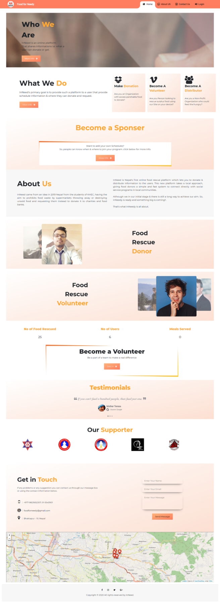
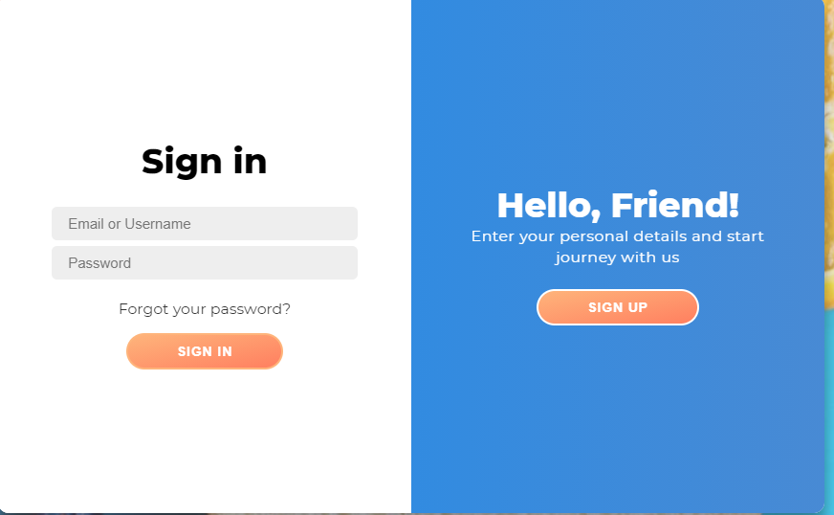
Front End Images

Slide 14
Result
Admin Back-end :
Provides short info of all with in a single page/dashboard.
Auto search in desire order in each page
Different page for different content
Food
User
Content
Message
Schedule
Admin

Slide 15
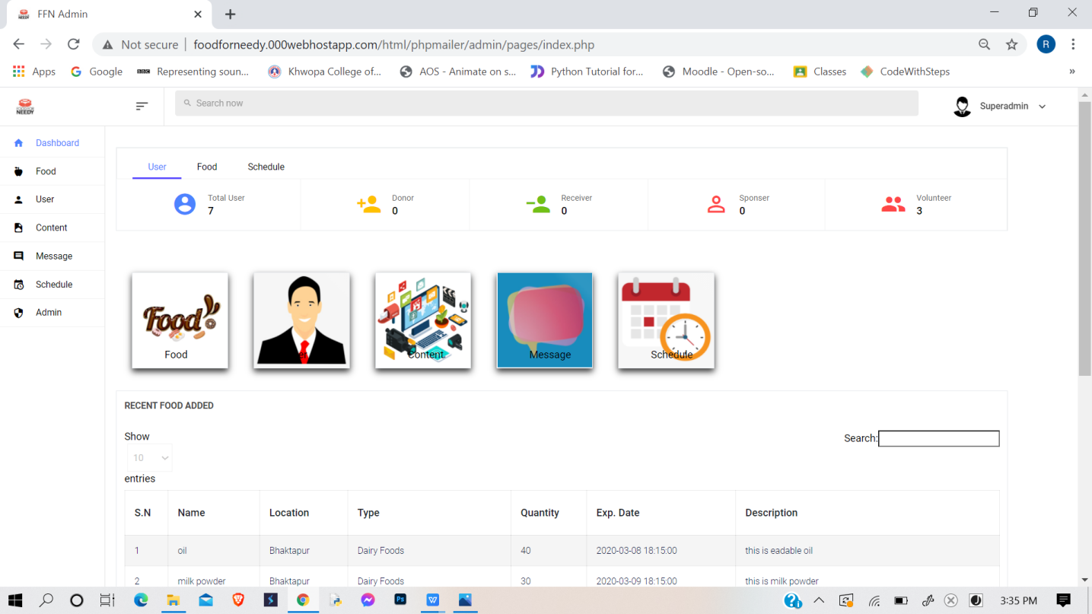
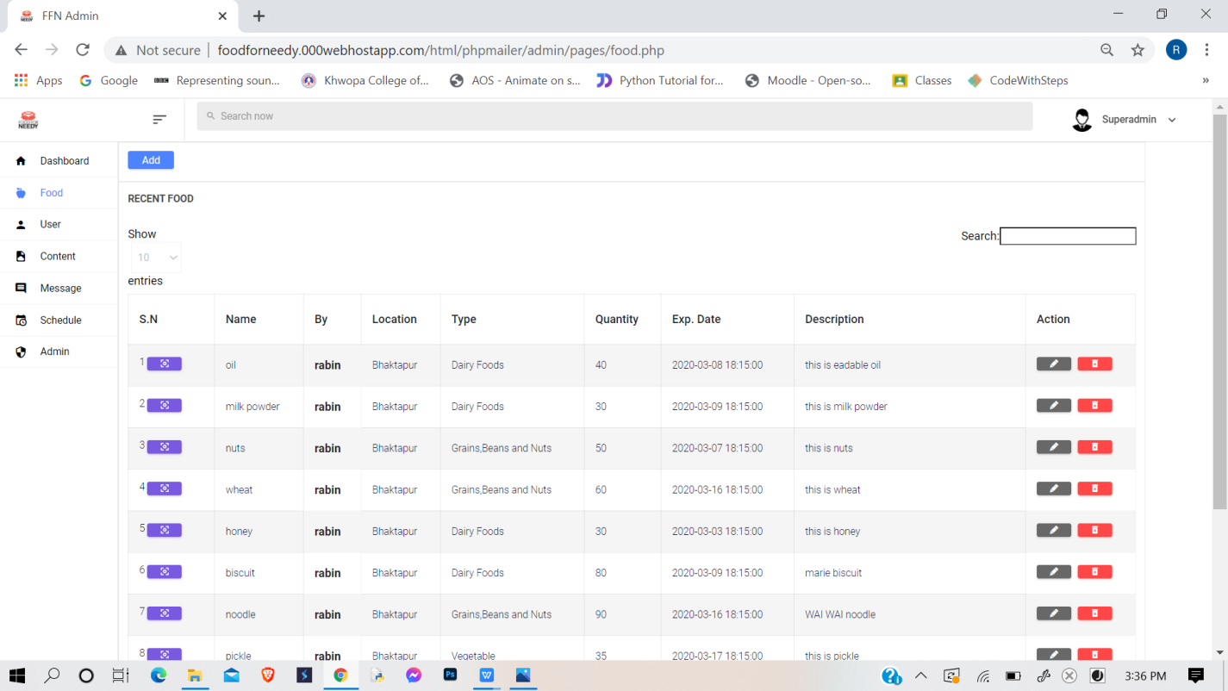
Images of Admin Back End

Slide 16
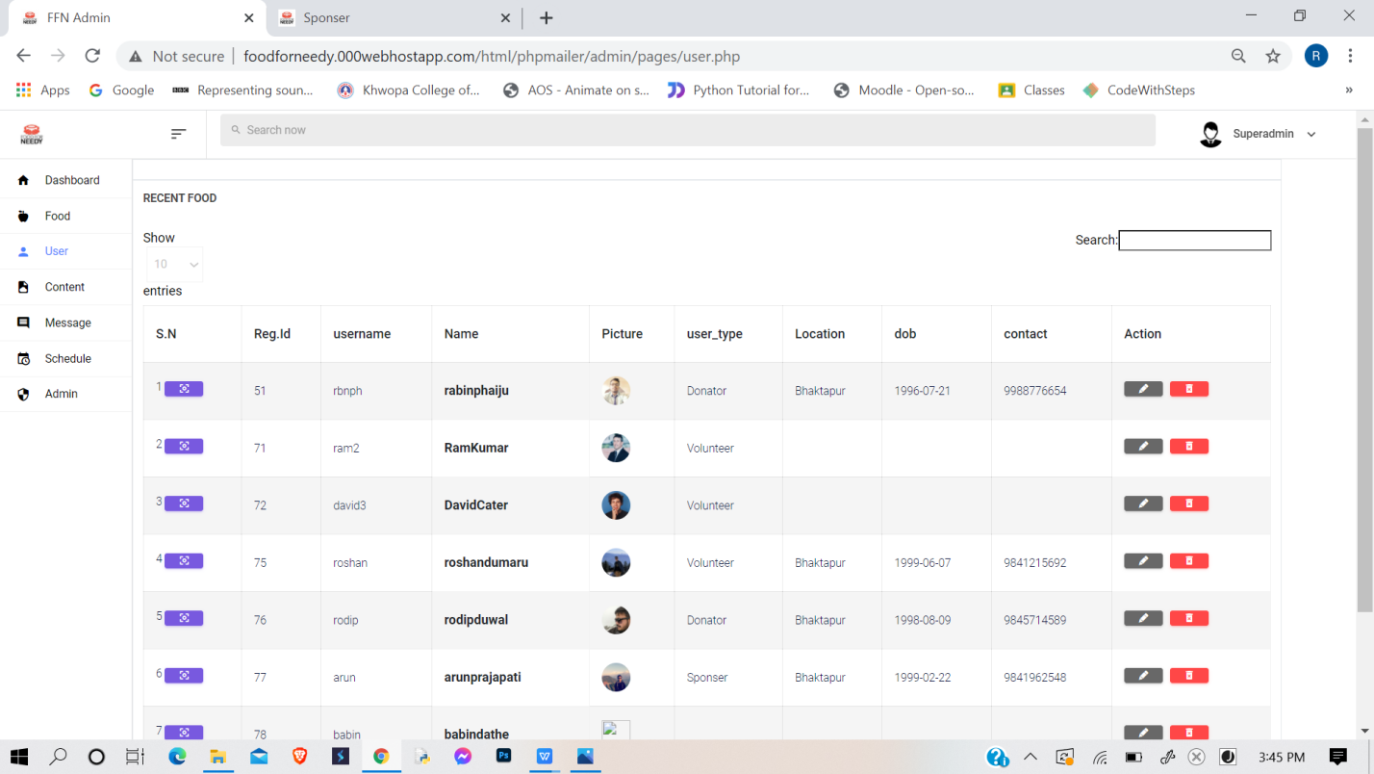
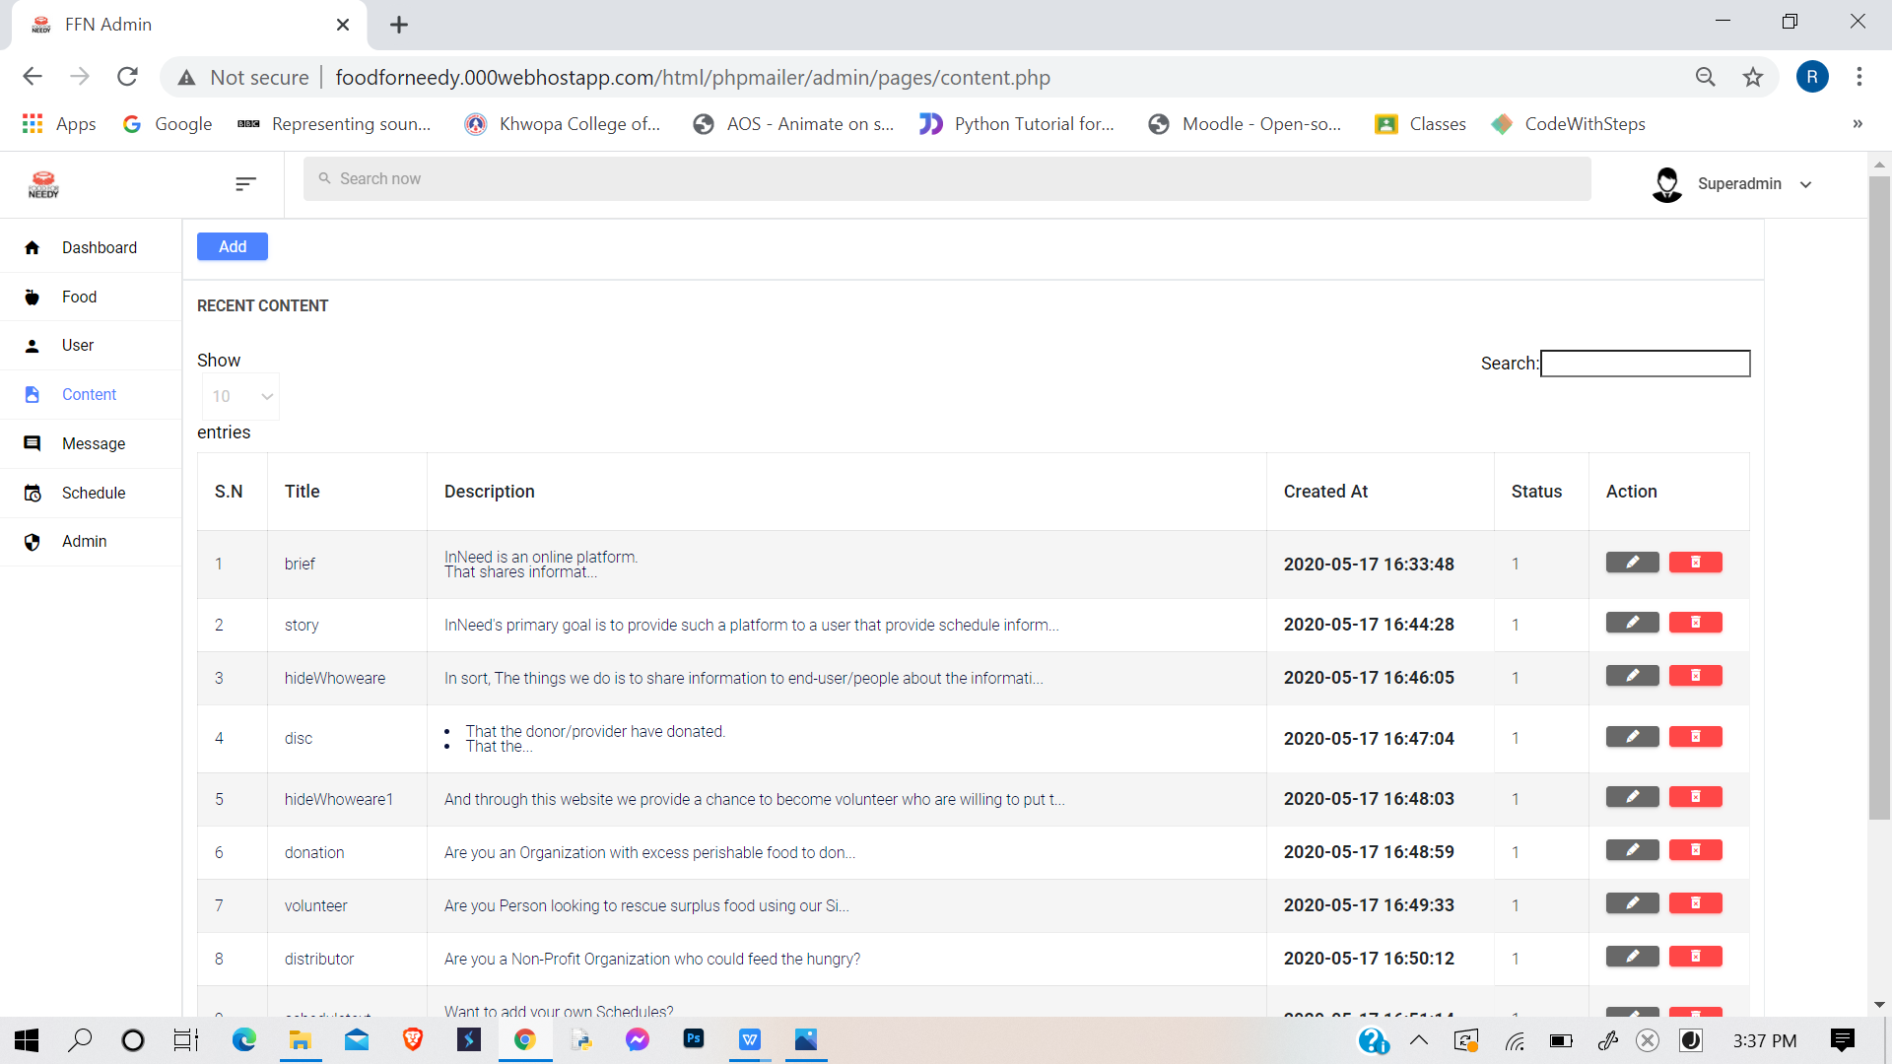
Images of Admin Back End

Slide 17
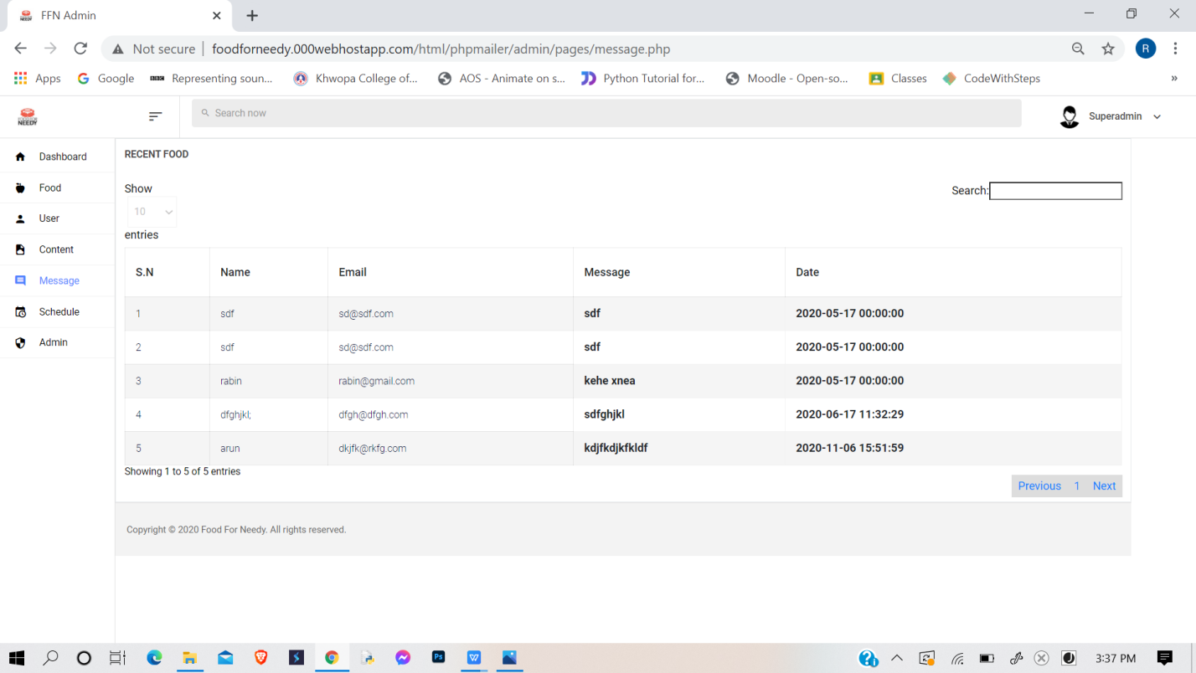
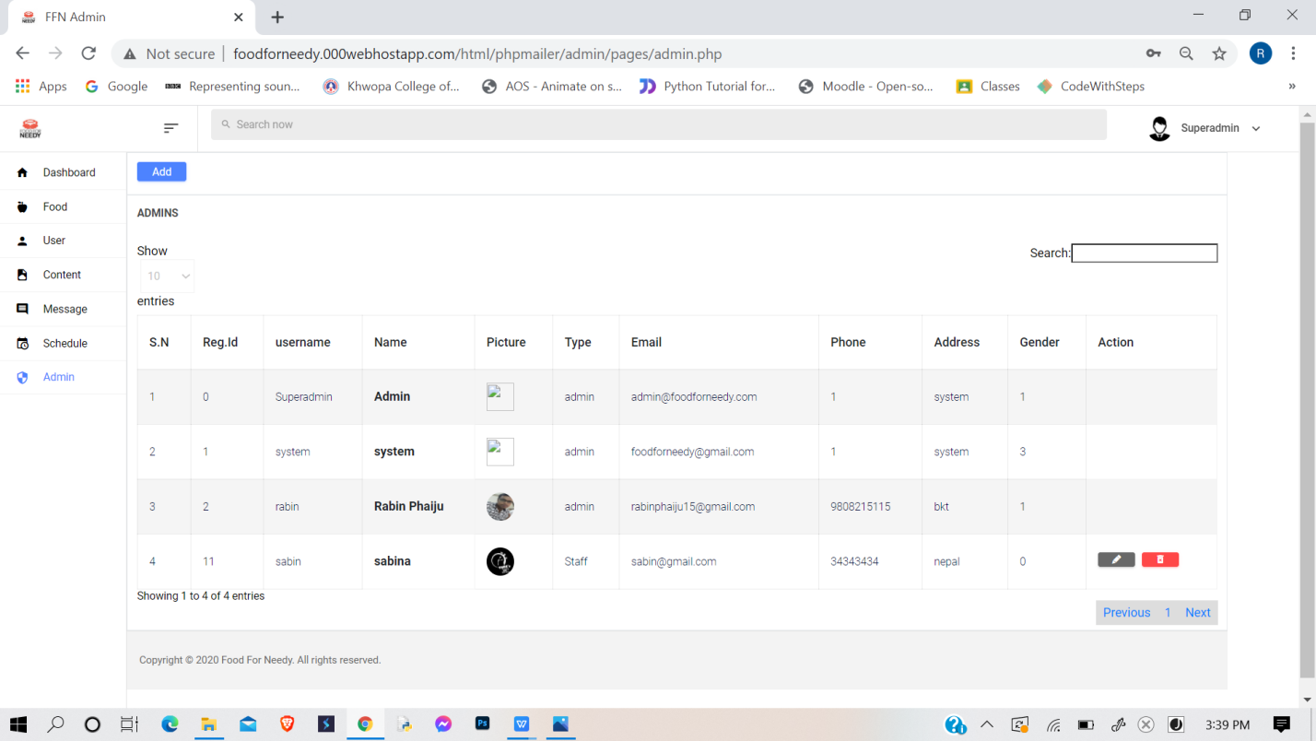
Images of Admin Back End

Slide 18
Result
User Log In :
Provides short info of all with in a single page/dashboard.
Info are visible to all user
Different page for different content
Profile
Food List
Conversation
Member
Record
Schedule

Slide 19
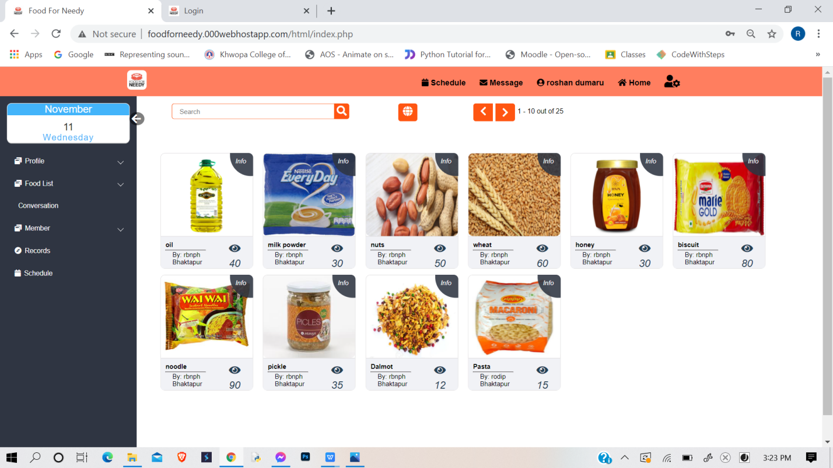
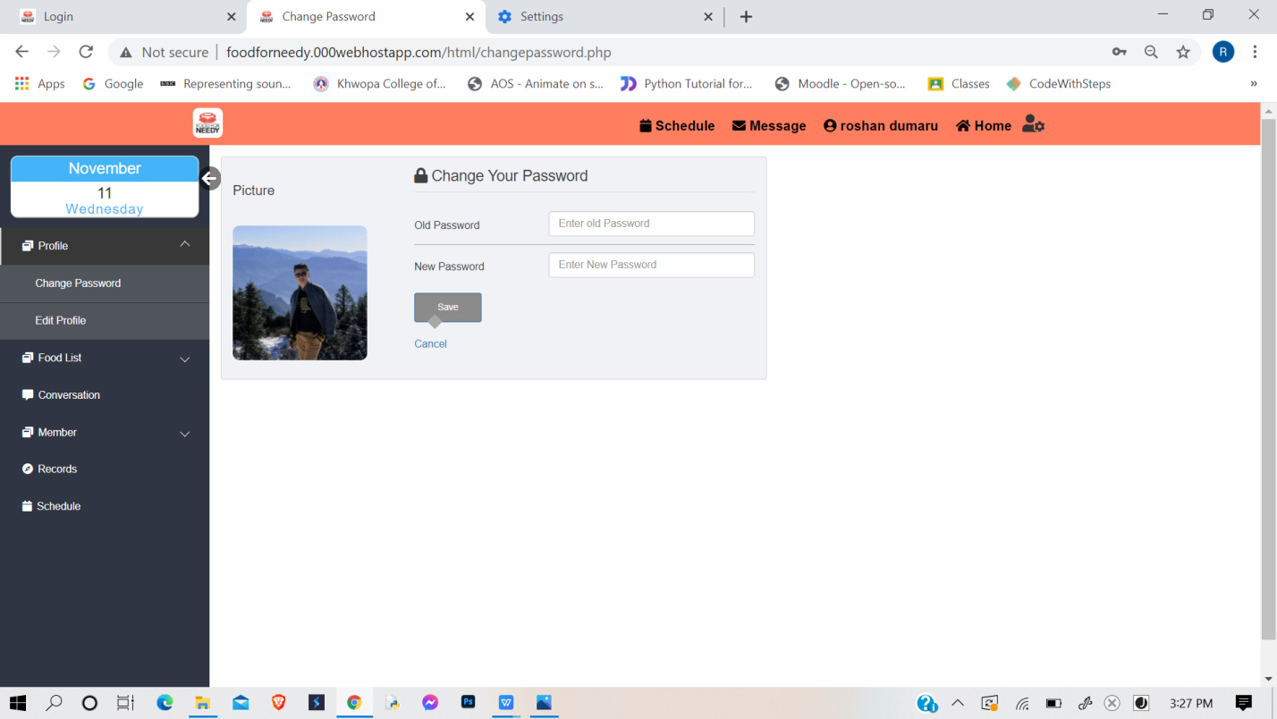
Images of User Log In

Slide 20
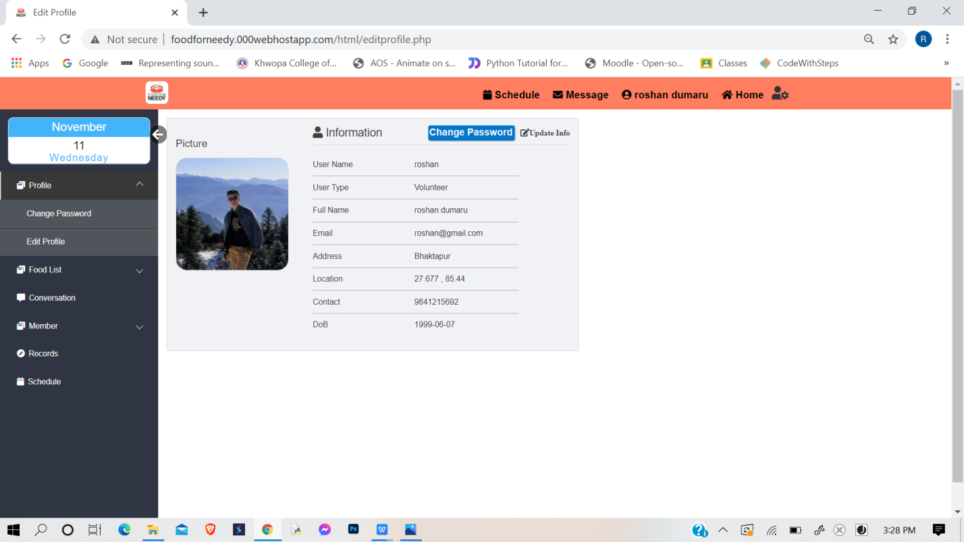
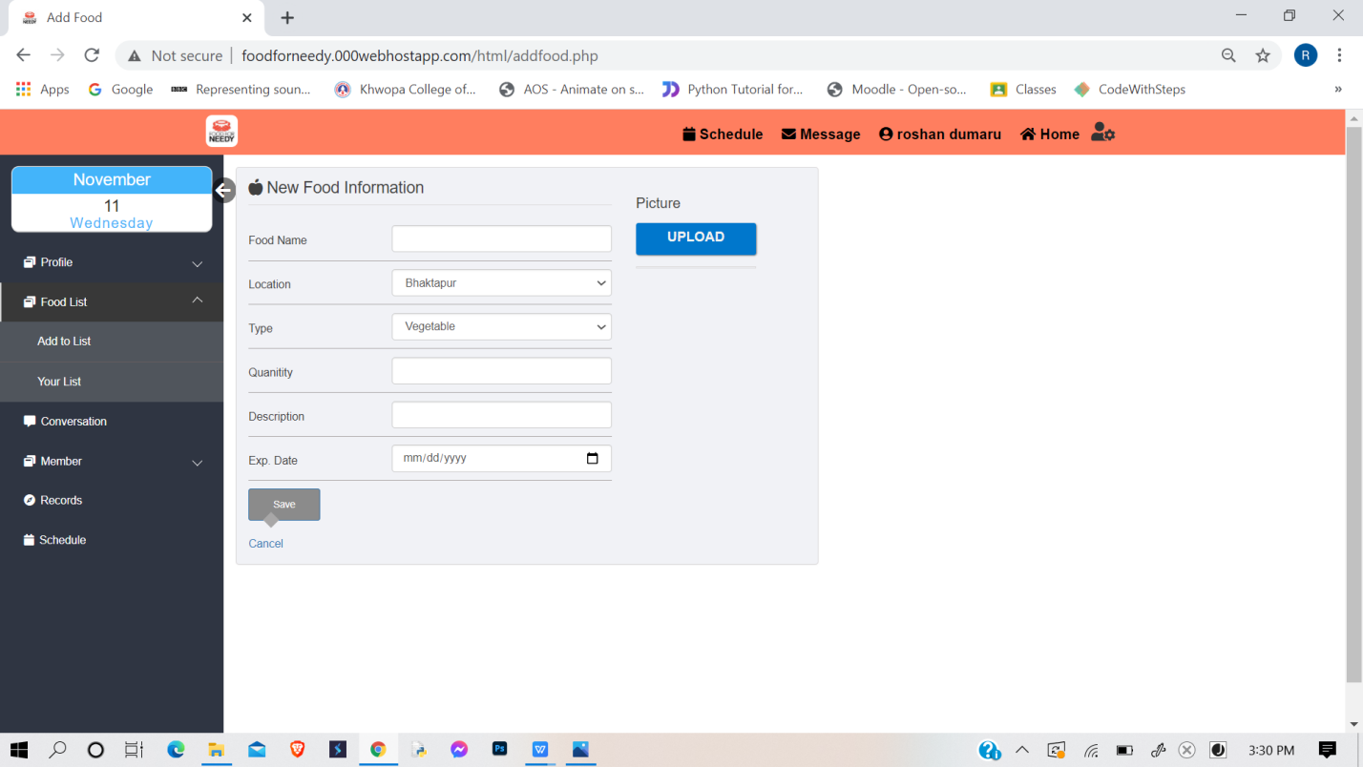
Images of User Log In

Slide 21
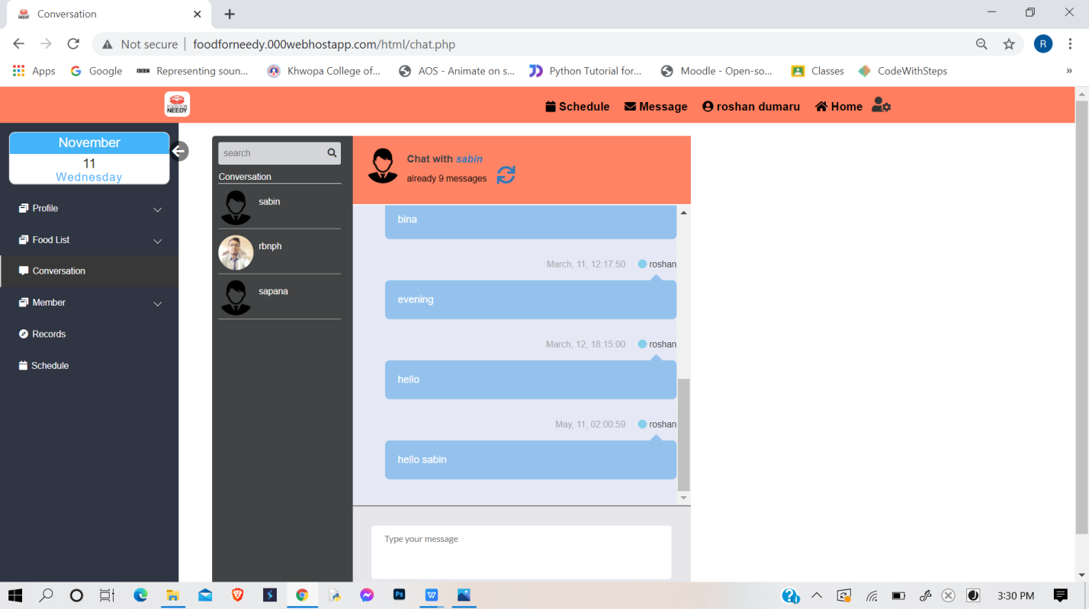
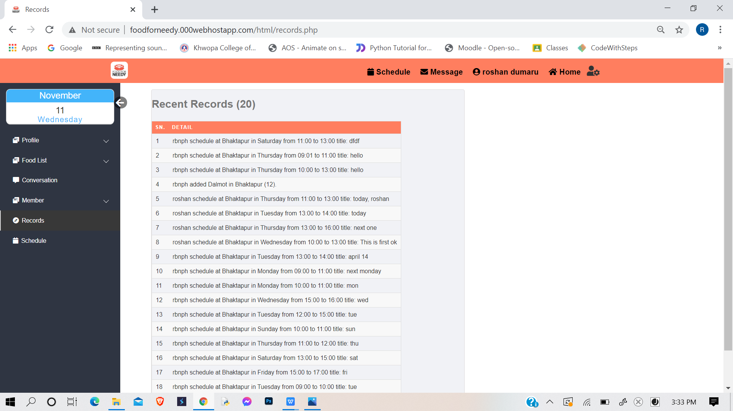
Images of User Log In

Slide 22
Conclusion & Further Enhancement
Conclusion
quite a challange as we were new to mailing system
Familiar with various programming language
Futher Enhancement
Inserting Geo-location system
Adding more features like message pop up
Creating own API

Slide 23
Reference
[1] “Atmail, Zentyal, scandalo”,http://freshmeat.sourceforge.net/tags/mail-server [2014-06-1]
[2] https://hamrobazaar.com/

Slide 24
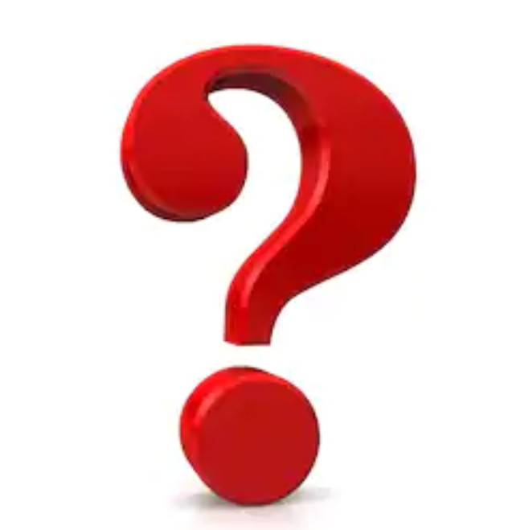
Any Queries.

Slide 25
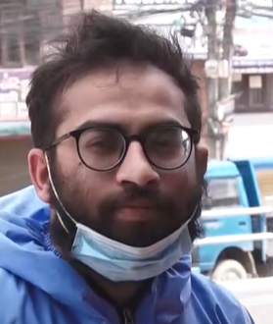

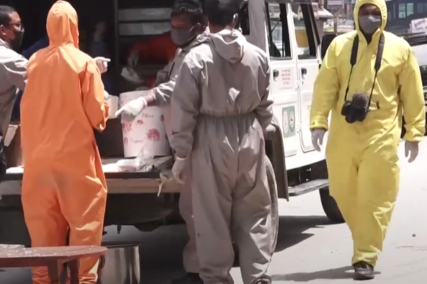
Manavsewa Ashram || Bhaktapur
Jamuna Paudel
Urbin Sapkota

Slide 26
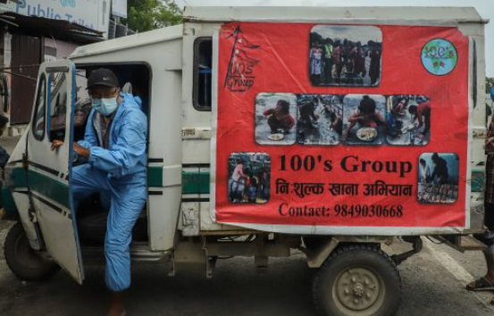
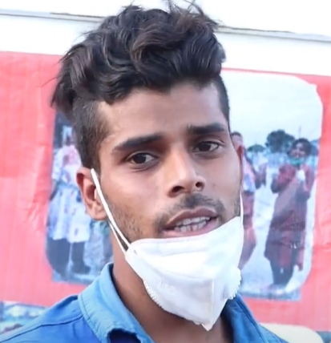
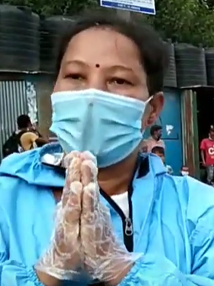
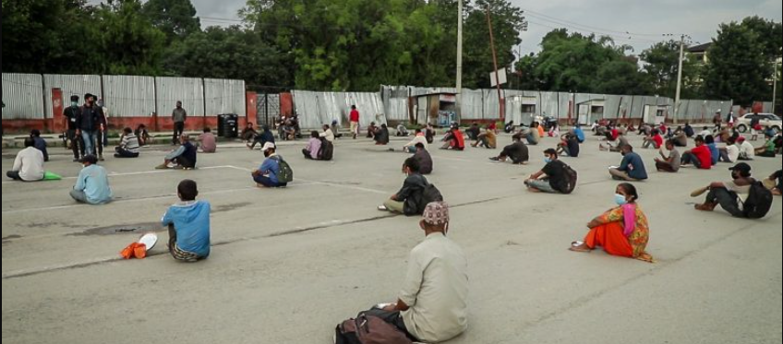
100s Group: Serving free meals to the needy
Ansu Yadav
Renu Raj Bhandari

Slide 27
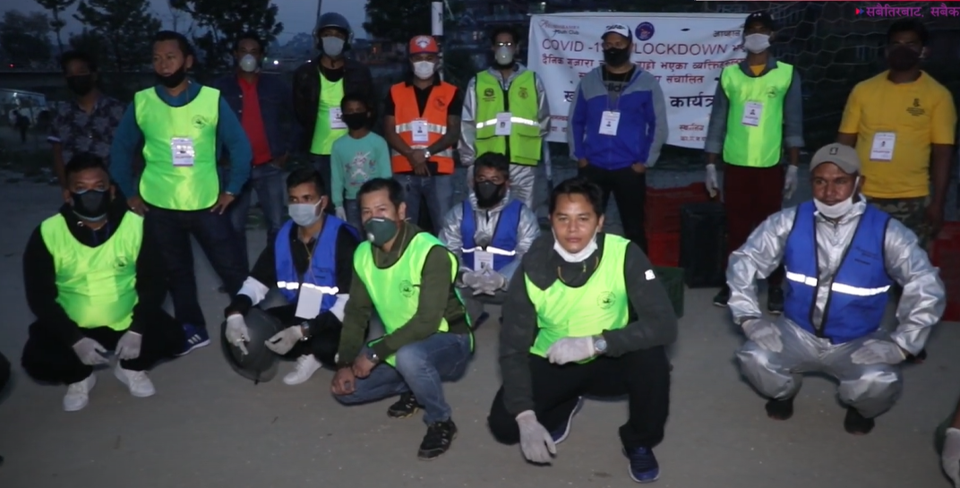

Suvarambha
Gunraj Pyakurel

